Slide 1

AGI Artificial General Intelligence
What is AGI?
Are LLMs AGI?
Benchmark AGI?
Should we fear AGI?
When will we reach AGI?
Download
Asim Munawar

Slide 2
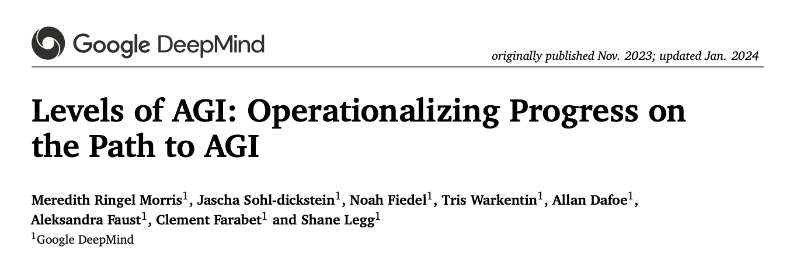
References
Meredith Ringel Morris et al, Levels of AGI: Operationalizing Progress on the Path to AGI, Jan 2024, https://arxiv.org/abs/2311.02462
Melanie Mitchell ,Debates on the nature of artificial general intelligence.Science383,eado7069(2024) DOI:10.1126/science.ado7069
Opinions from Academic/Industry experts

Slide 3


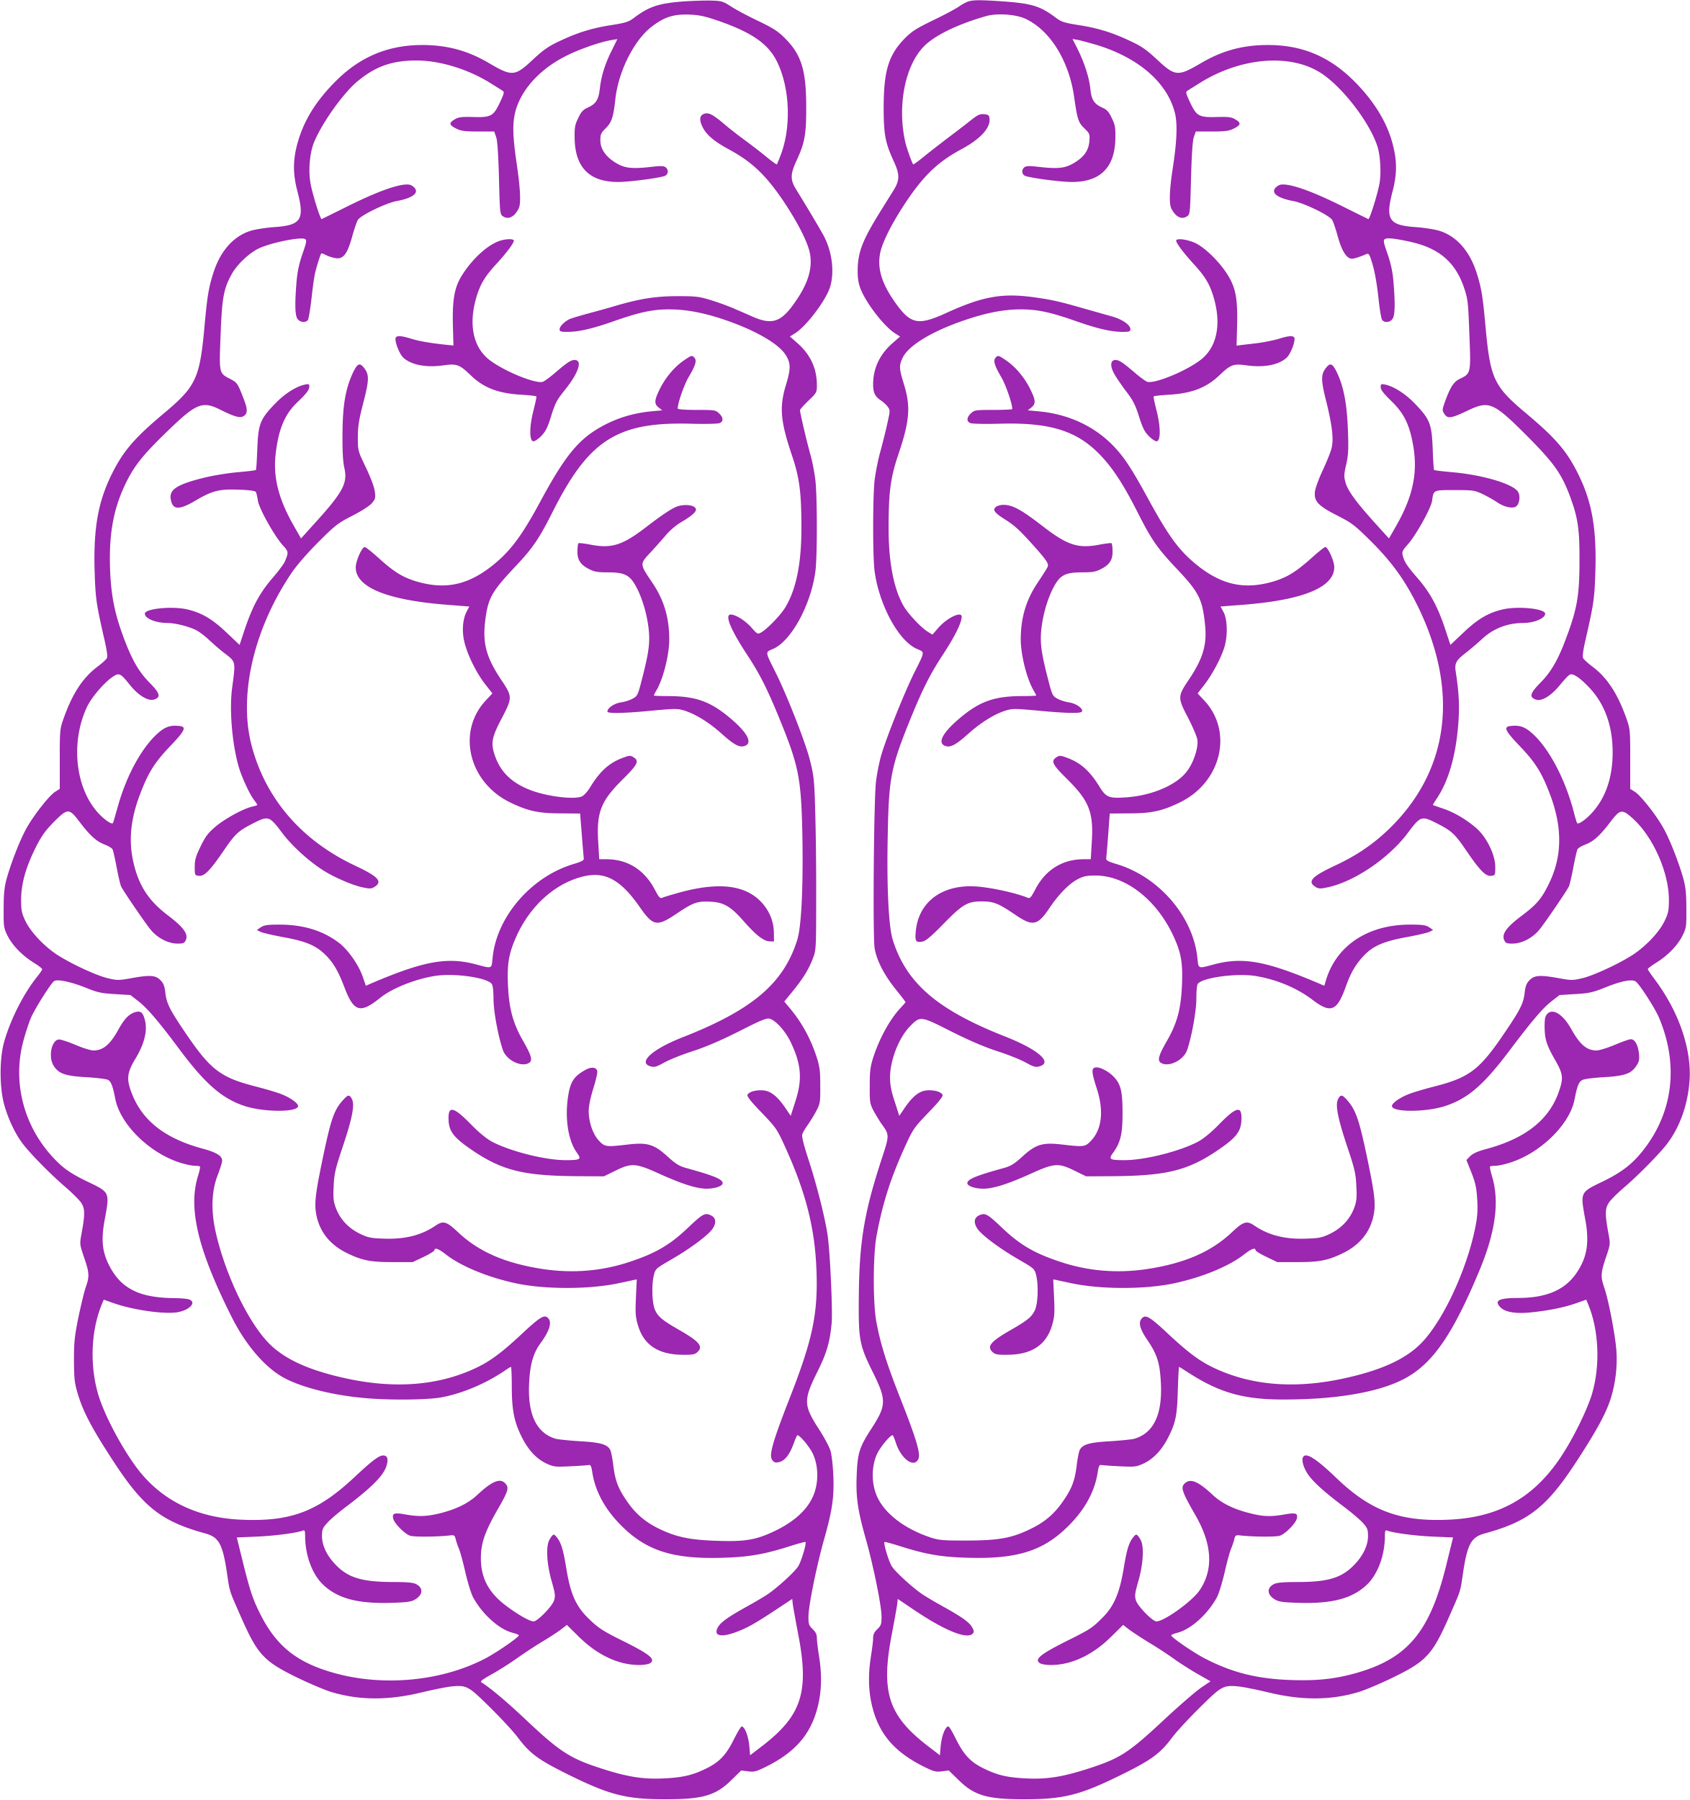
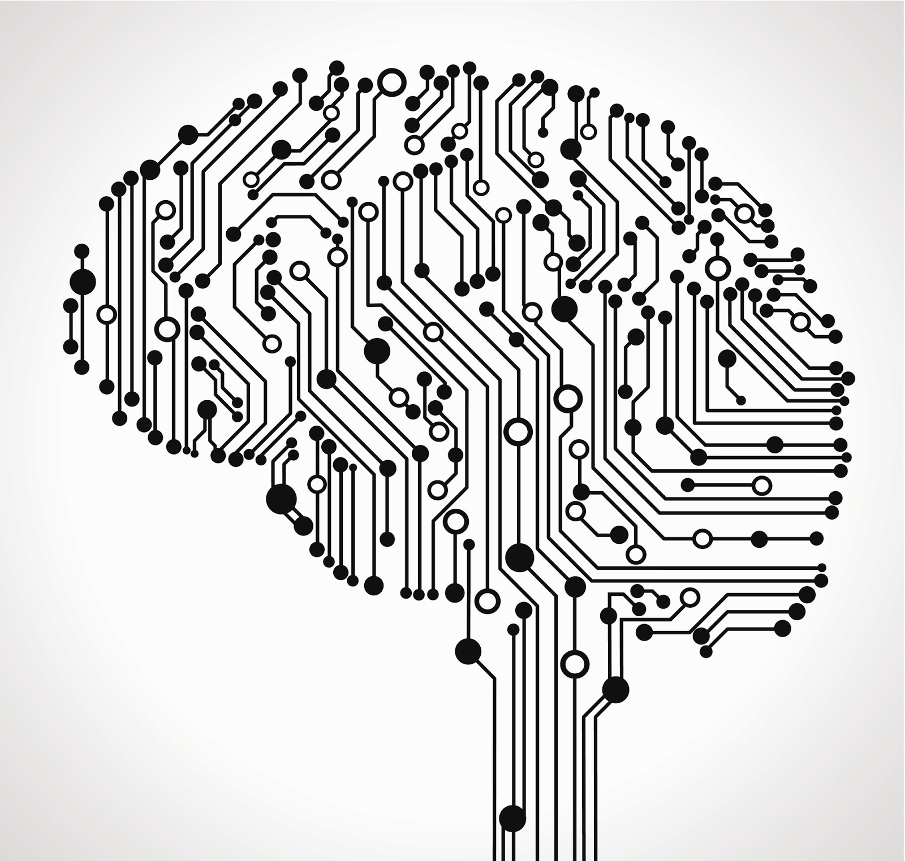
What is AGI?
Human intelligence has always been a north star or holy grail for the AI.
AGI is often considered as an AI that is at least as intelligent as an average Human.
Should AI architectures exactly mimic Human brains?
Neural networks are loosely inspired by the brain.
AI
Do we want to create an AI that is exactly equivalent to a Human in it’s capabilities?

Slide 4
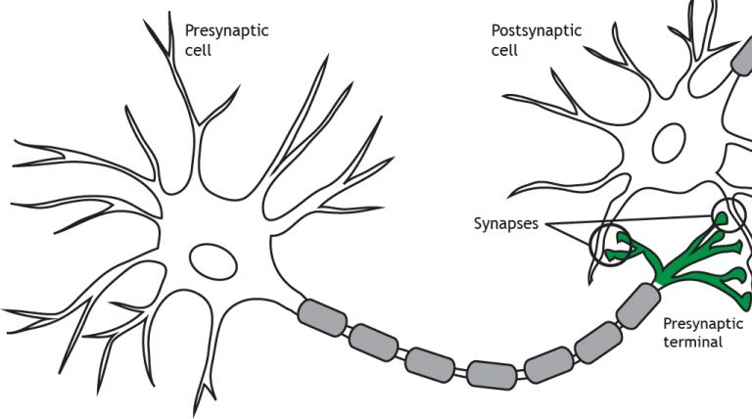
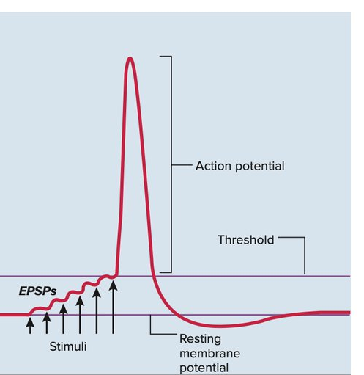
Human Brain
Dendrites
Human brain contains an estimated:
86 billion neurons
100 trillion synapses
Runs on 20 Watts
Where are memories stored?
Synaptic connections
How do our brain learn?
Neurons that fire together wire together
Few interesting properties of brain:
Associative memory
Sequential memory
System2 → System1
Axon
https://www.quora.com/What-is-the-maximum-change-in-electrical-potential-that-1-single-spike-of-a-presynaptic-neuron-can-induce-in-the-postsynaptic-neuron-at-the-level-of-1-single-synapse
Notes:
EPSP: Excitatory postsynaptic potential

Slide 5
The evolution of AI
Narrow AI
Emerging
Single-task, single-domain, with superhuman accuracy
Requires large amounts of labeled data
Broad AI
Disruptive and Pervasive
Multi-task, multi-domain, multi-modal
Foundation models
Learning + Reasoning
Safety and Trust
General AI
Revolutionary
Cross-domain learning and reasoning
Broad autonomy with moral reasoning
We are here?
2050 and beyond

Slide 6


Testing AGI – Turning Test
Turing Test (Turing, 1950) is the most well-known attempt to operationalize an AGI-like concept.
Turing’s “imitation game” was presented as a way to operationalize the question of whether machines could think, and asks a human to interactively distinguish whether text is produced by another human or by a machine.
Some LLMs can pass some framings of the Turing Test, so this test is insufficient for benchmarking AGI.
Capabilities rather than processes
Turning test however emphasis on capability rather than process. Which we tend to agree with.
It is difficult to measure weather a machine can think in philosophical terms.
It is easy for us to measure what a machine can do.
Evaluating AGI is not easy (retrieval, power, …)

Slide 7

Retrieval (with interpolation) vs. Reasoning
Will a machine be Intelligent, if ….
It has access to
All the existing text, images, knowledge that was ever created
Very efficient retrieval engine

Slide 8
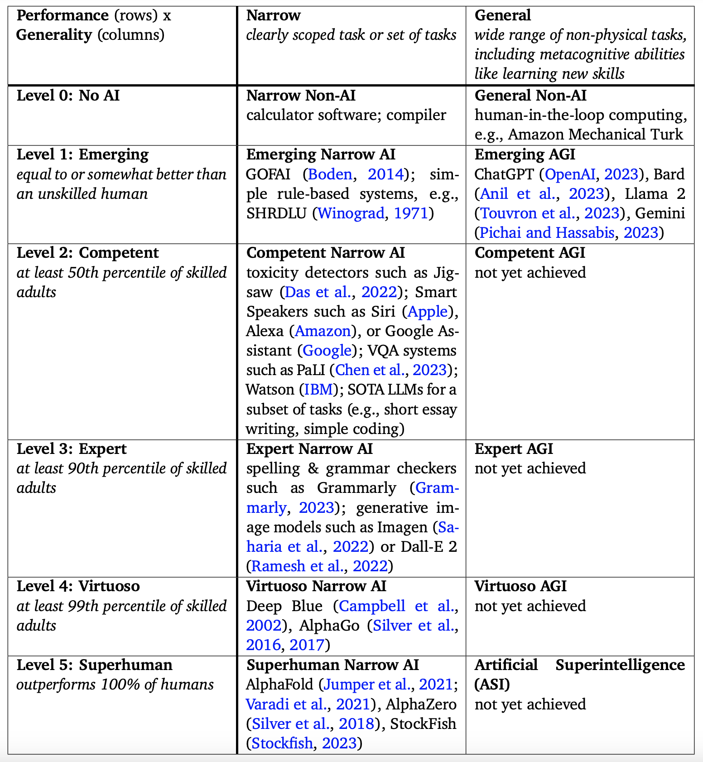
Levels of AGI and Reality Check

Slide 9
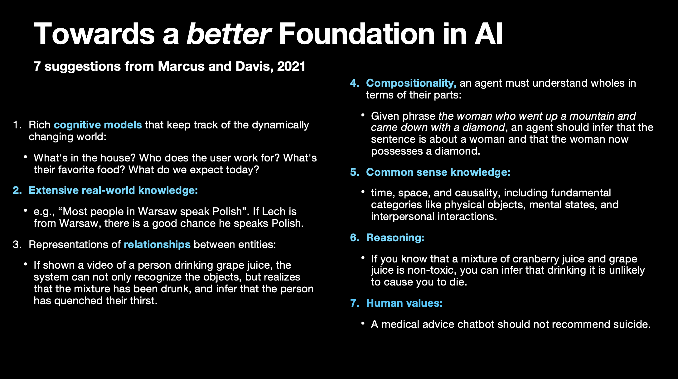
How close are we to AGI?
With LLMs we have achieved 1 and to some extent 2
Presented by Gary Marcus at NucLear Workshop at AAAI 2024, Titled: No AGI without NeuroSymbolic AI

Slide 10
Defining AGI: Six Principles
Focus on Capabilities, not Processes
Focus on Generality and Performance
Focus on Cognitive and Metacognitive Tasks
Focus on Potential, not Deployment
Focus on Ecological Validity
For benchmarking, we should choose tasks that people value.
Focus on the Path to AGI, not a Single Endpoint
An AGI system does not need to think in the same way a human does.
It needs to poses similar capabilities as humans.
Generality and performance are both important.
Ability to perform physical tasks should not be considered a necessary prerequisite to achieving AGI.
Metacognitive capabilities (such as the ability to learn) are key prerequisites for systems to achieve generality.
Embodiment is sometimes considered crucial for achieving AGI.
Demonstrating that a system can perform a requisite set of tasks at a given level of performance should be sufficient.
Deployment can have many issues such as social, legal, ethical, safety etc. These issues while extremely important, should not be considered for declaring a system AGI or not.
Traditional benchmarks can usually be hacked to show very high numbers with non-AGI systems.
One thing that LLMs have already taught us is that one size does not fit all.

Slide 11
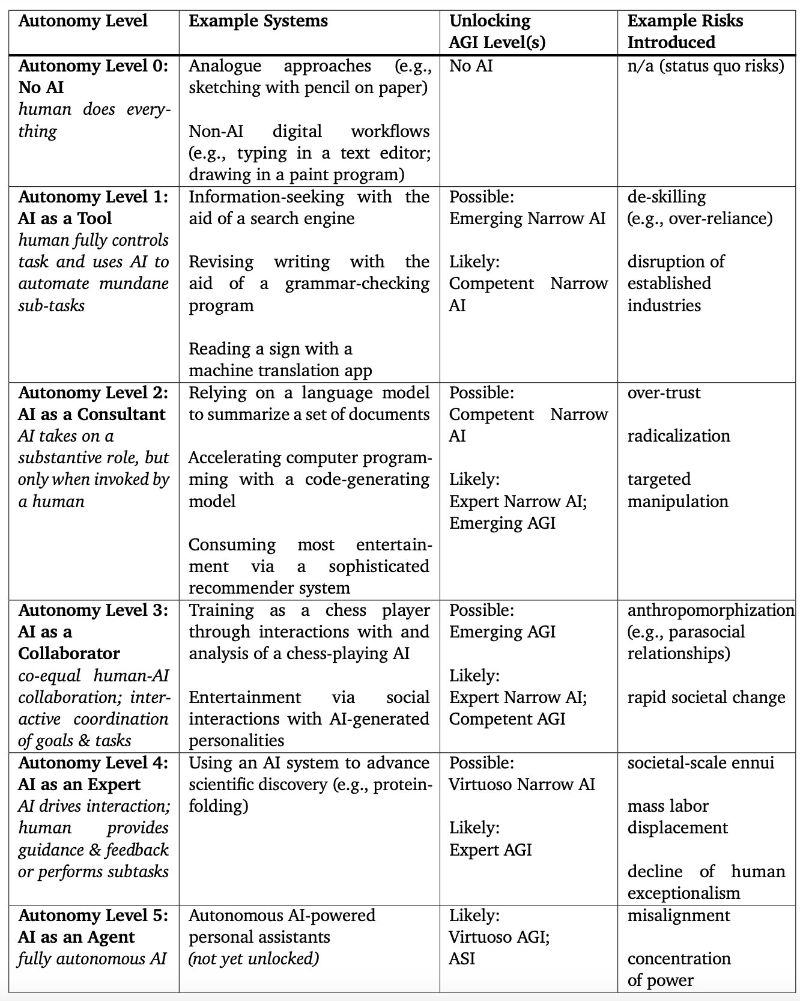
Should we fear AGI?
Risks of AGI
We fear AGI, mostly because of the depiction of AI in novels and movies.
There is no reason to believe that an AGI system will destroy Human race.
That being said, AGI can and will affect us in many ways.

Slide 12

Will unlimited compute and data give us AGI?
Qualitative Limits
More data and computation ≠ qualitative leap
Human-like understanding is missing
Understanding and Reasoning
AGI needs deep, abstract reasoning
Current AI lacks basic human intuition
Learning Efficiency
Humans excel with limited data
More data can mislead models
Ethical Issues
More data can increase bias
Complexity reduces trust and clarity
Need for Innovation
AGI requires novel approaches
Insights beyond computer science are crucial

Slide 13
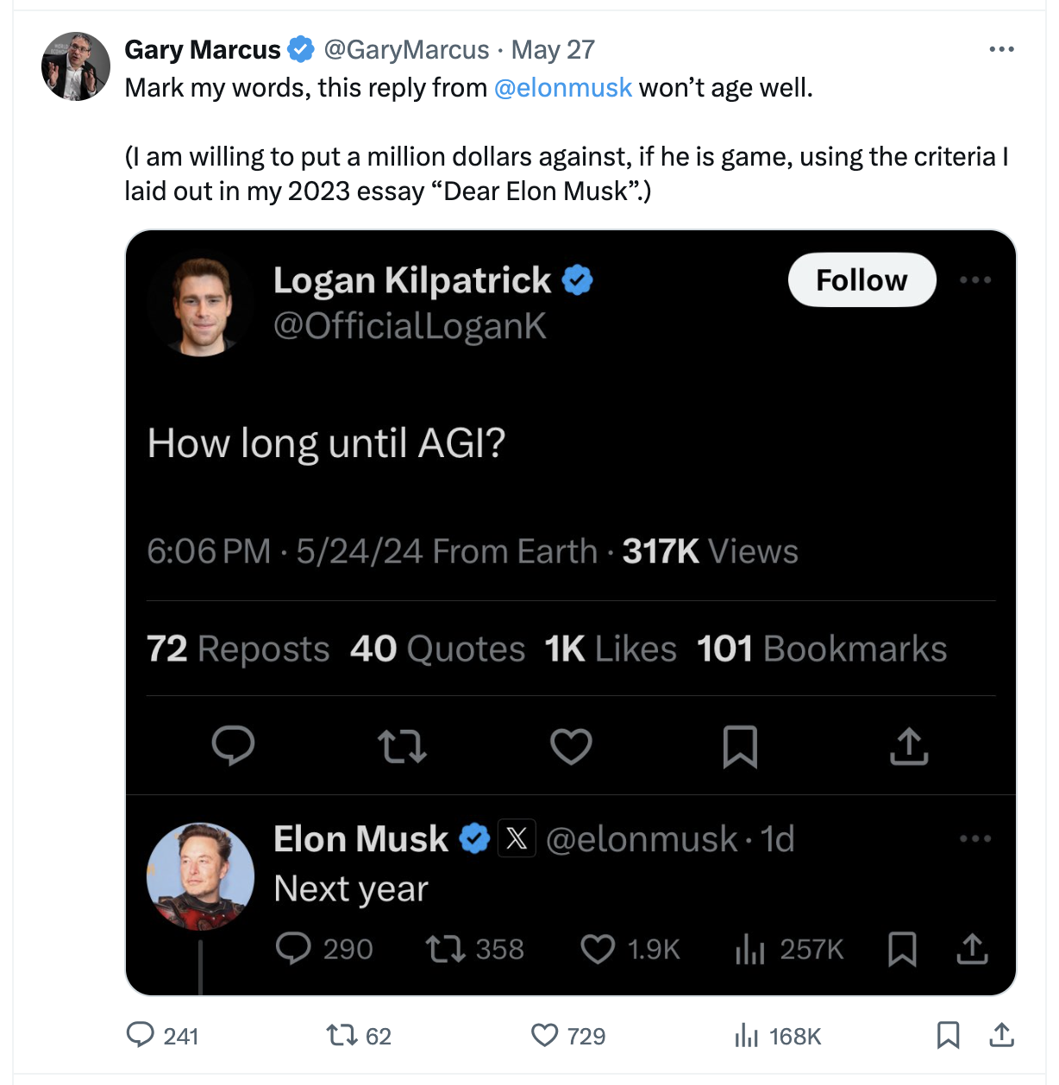

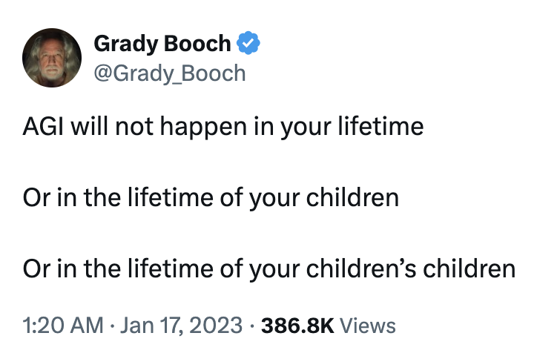
Quotes/Opinions from Industry and Academic Experts
“Mitigating the risk of extinction from AI should be a global priority alongside other societal-scale risks such as pandemics and nuclear war."
statement signed by OpenAI CEO Altman, DeepMind CEO Hassabis, Anthropic CEO Amodei, Turing Prize winners Hinton and Bengio, May 2023
On how AI could kill humans (CNN, May 2023)
Interviewer: “How could [AI] kill humans?”
Hinton: “If it gets to be much smarter than us, it’ll be very good at manipulation, because it will have learned that from us. There are very few examples of a more intelligent thing being controlled by a less intelligent thing. It’ll figure out ways of manipulating people to do what it wants.”
Stephen Hawking: "The development of full artificial intelligence could spell the end of the human race … It would take off on its own, and re-design itself at an ever increasing rate" (BBC, Dec 2014)
https://www.stop.ai/quotes

Slide 14




Effects of AGI
Economic Impact
AGI could transform industries by automating complex tasks, leading to increased productivity but also potential job displacement.
Ethical and Social Challenges:
The development and deployment of AGI raise significant ethical questions, including issues of bias, privacy, and decision-making autonomy.
Scientific and Technological Advancements
AGI could accelerate research and development across various fields, solving problems that are currently beyond human capability.
Regulatory and Governance Issues
Ensuring the safe and fair use of AGI will require new regulations and governance structures to address potential risks and ensure public trust.

Slide 15
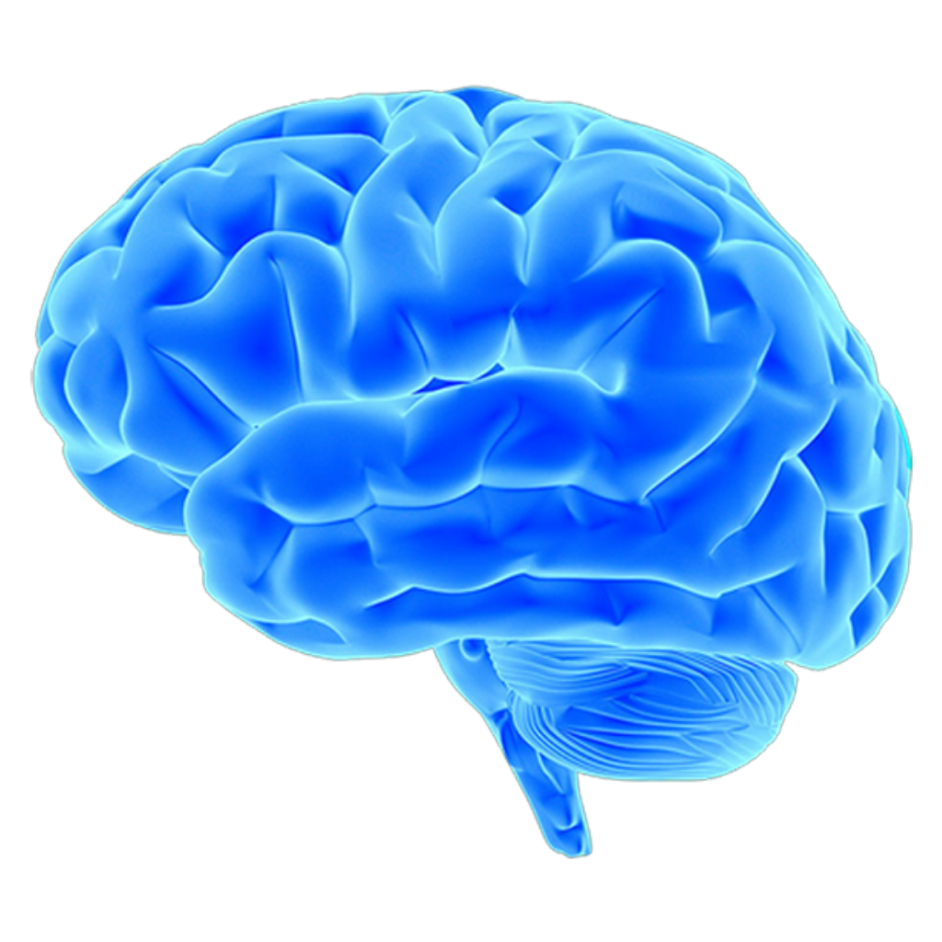

What would be my AGI Test?
A system can called an AGI, when it can operate in a new environment by following higher level commands.
Example Scenario
Put a robot in your house, give it access to an AGI brain, and just ask it to make coffee for you. It should understand the rest. No need to share the map of the house, location of the cabinets, fancy prompts etc.
AGI

Slide 16





youtube.com/@asimmunawar
x.com/asimunawar
linkedin.com/in/asimmunawar
https://asimmunawar.github.io/ (Talks)
Download
Asim Munawar

